Slide 1
ChatApp - Game Day
Comp 504 final ChatApp presentation
11/30/2018

Slide 2
Features
Json format data communication
 | Example | Type
frontend to backend | { "commandType":"message", "name": [-1 | userId], //-1 stands for send all "content":"hello" }
backend to frontend | {"message":{"id":1, "roomId":-1, "senderId":3, "receiverId":4, "message":"hello", "isReceived":false}, "type":"NewMessageResponse" }
signup
joinRoom
message
ack
chatHistory
leaveRoom
AckResponse
NewMessageResponse
RoomNotificationResponse
RoomUsersResponse
UserChatHistoryResponse
UserRoomResponse

Slide 3
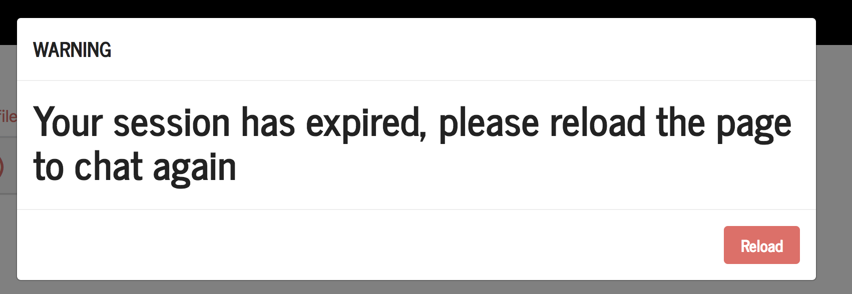
Features
after not receiving messages for 5 minutes, session will expire and re-register operation is needed.
During the active status, sending a heart beat message per 30 seconds to maintain the user’s connection.

Slide 4
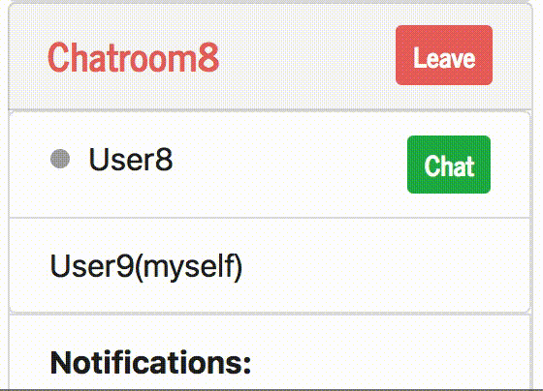
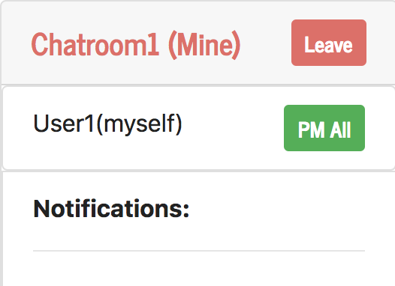
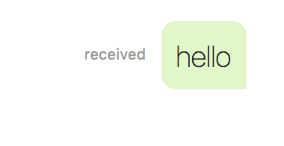
Features
new message notification
message received notification (ack)
reset chatroom if the owner leaves

Slide 5
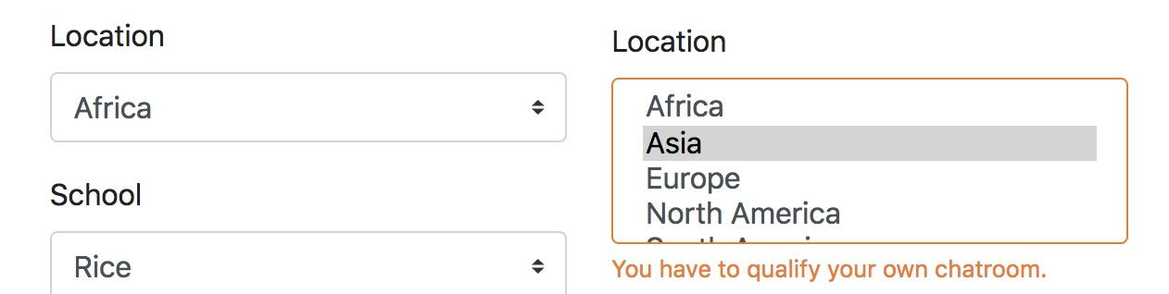
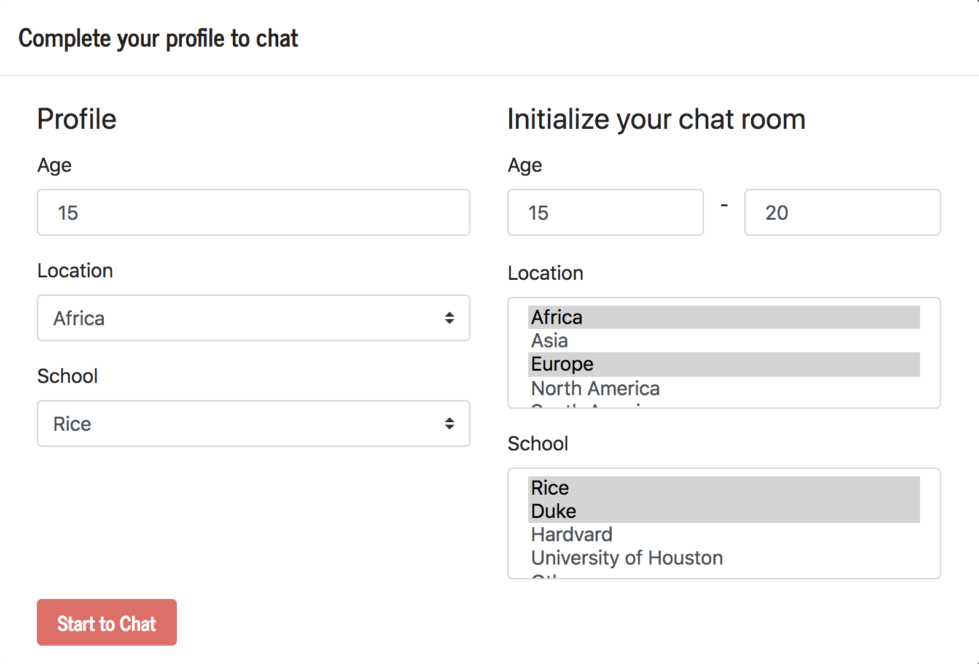
Sign Up
Complete personal profile and set chatroom restriction
{
"commandType":"signup",
"age":18,
"location":"North America",
"school":"Rice", // user profile
"ageResL":15, //minimum age
"ageResU":20, //maximum age
"locRes":["North America"], // location restriction
"schoolRes":["Rice"] // school restriction
}

Slide 6
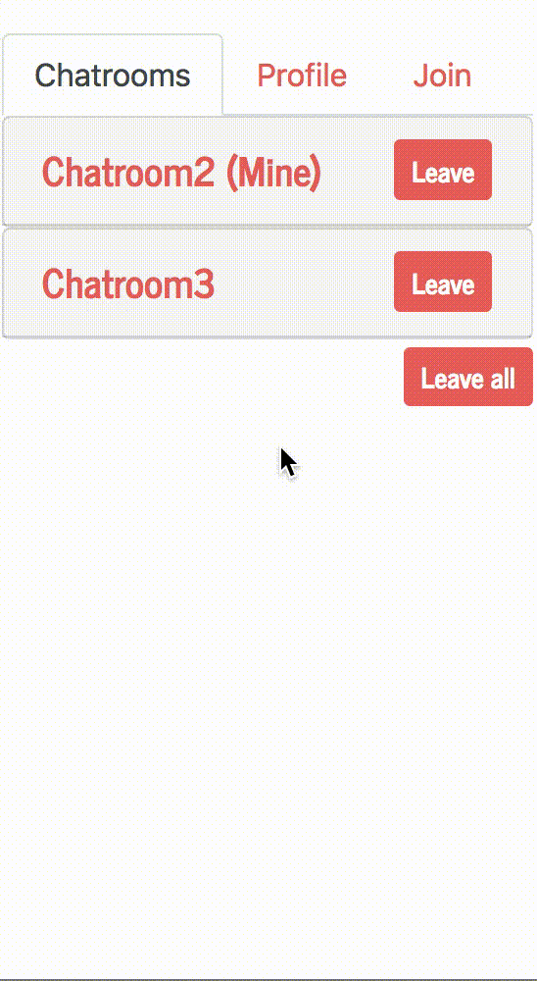
Join ChatRoom
In the “Join” tab, all the joinable chatrooms are listed.
{
"commandType":"joinRoom”,
"chatroom": [roomId]
}

Slide 7
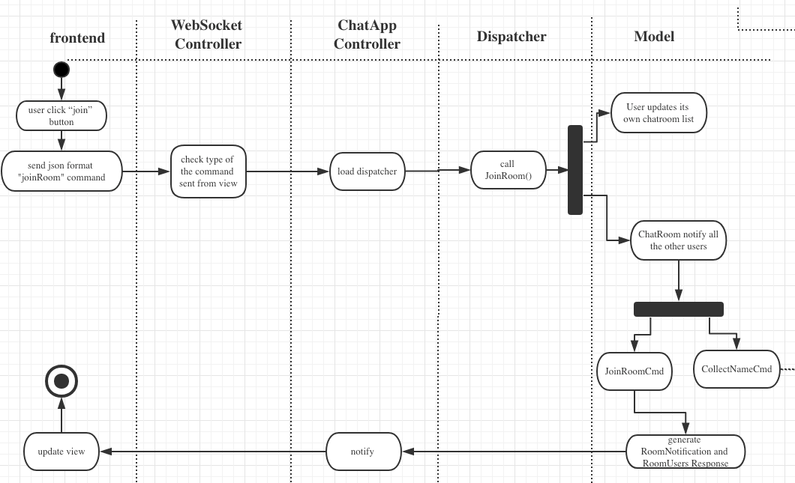
Join ChatRoom - Activity Diagram

Slide 8
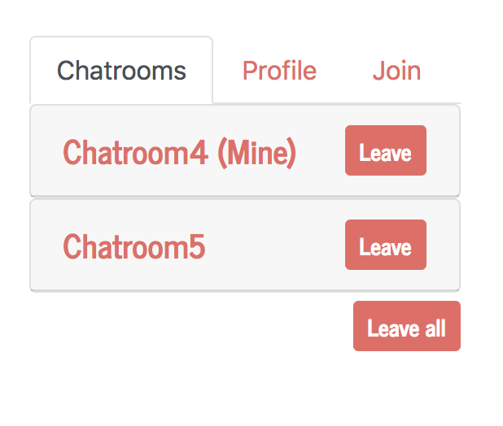
leave ChatRoom
Support both “leave” and “leave all”
{
"commandType":"leaveRoom",
"chatroom": [-1 | roomId]
}
-1 stands for leaving all the chatrooms

Slide 9
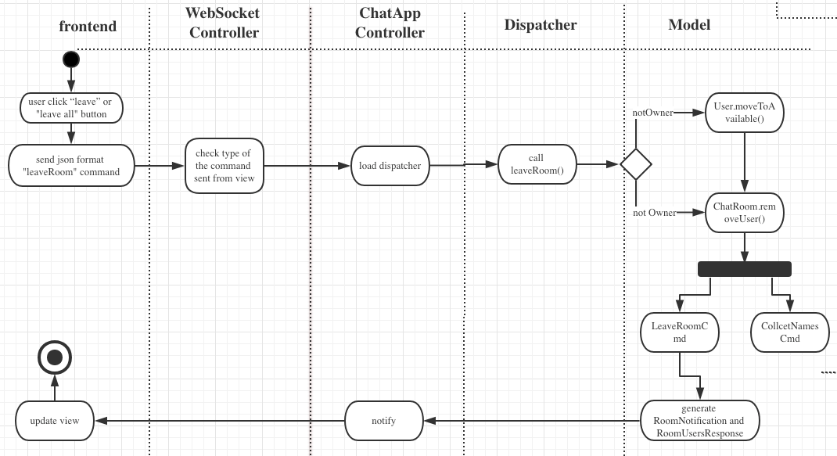
Leave ChatRoom - Activity Diagram

Slide 10
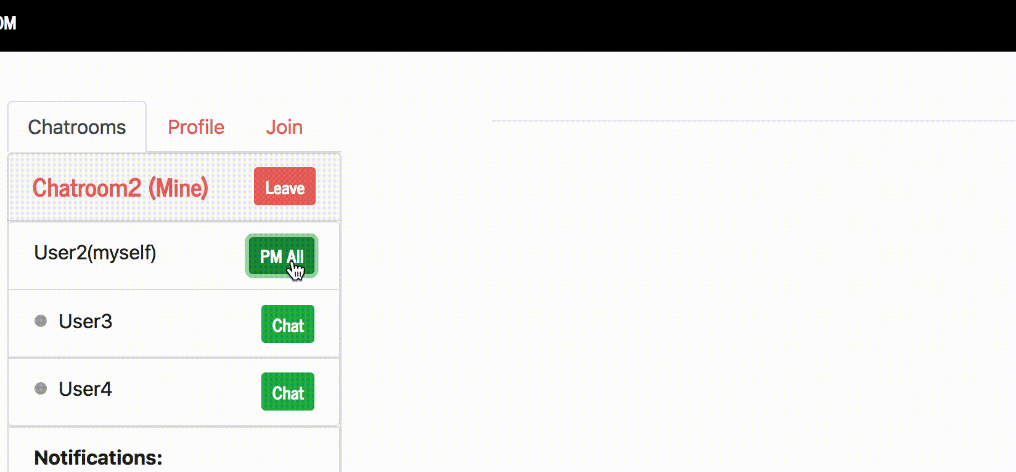
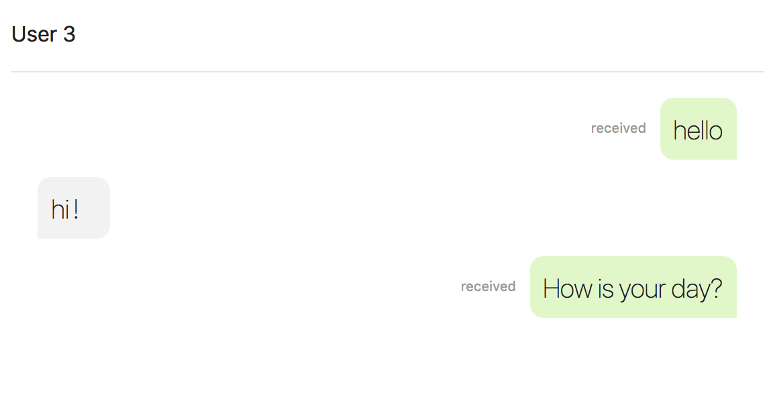
Send Message
The owner of the chatRoom can send message to all the other users.
send message to all
Users in the same chatRoom can chat with anyone else in a private chat screen.
{
"commandType":"message",
"name": [-1 | userId],
"content":"hello"
}
-1 stands for sending message to all the other users
private chatRoom

Slide 11
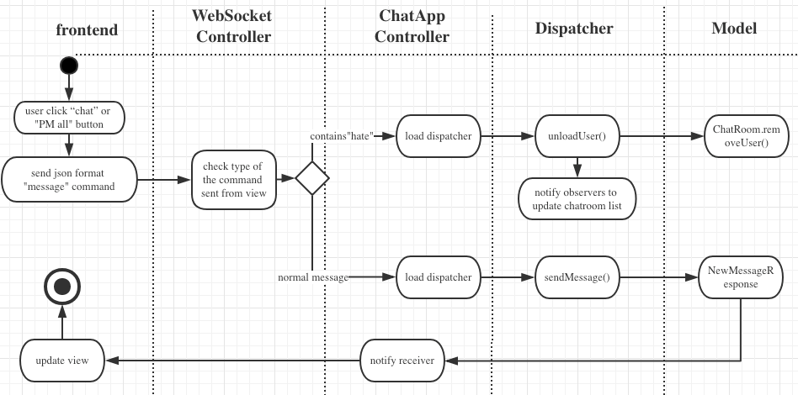
Send Message - Activity Diagram

Slide 12
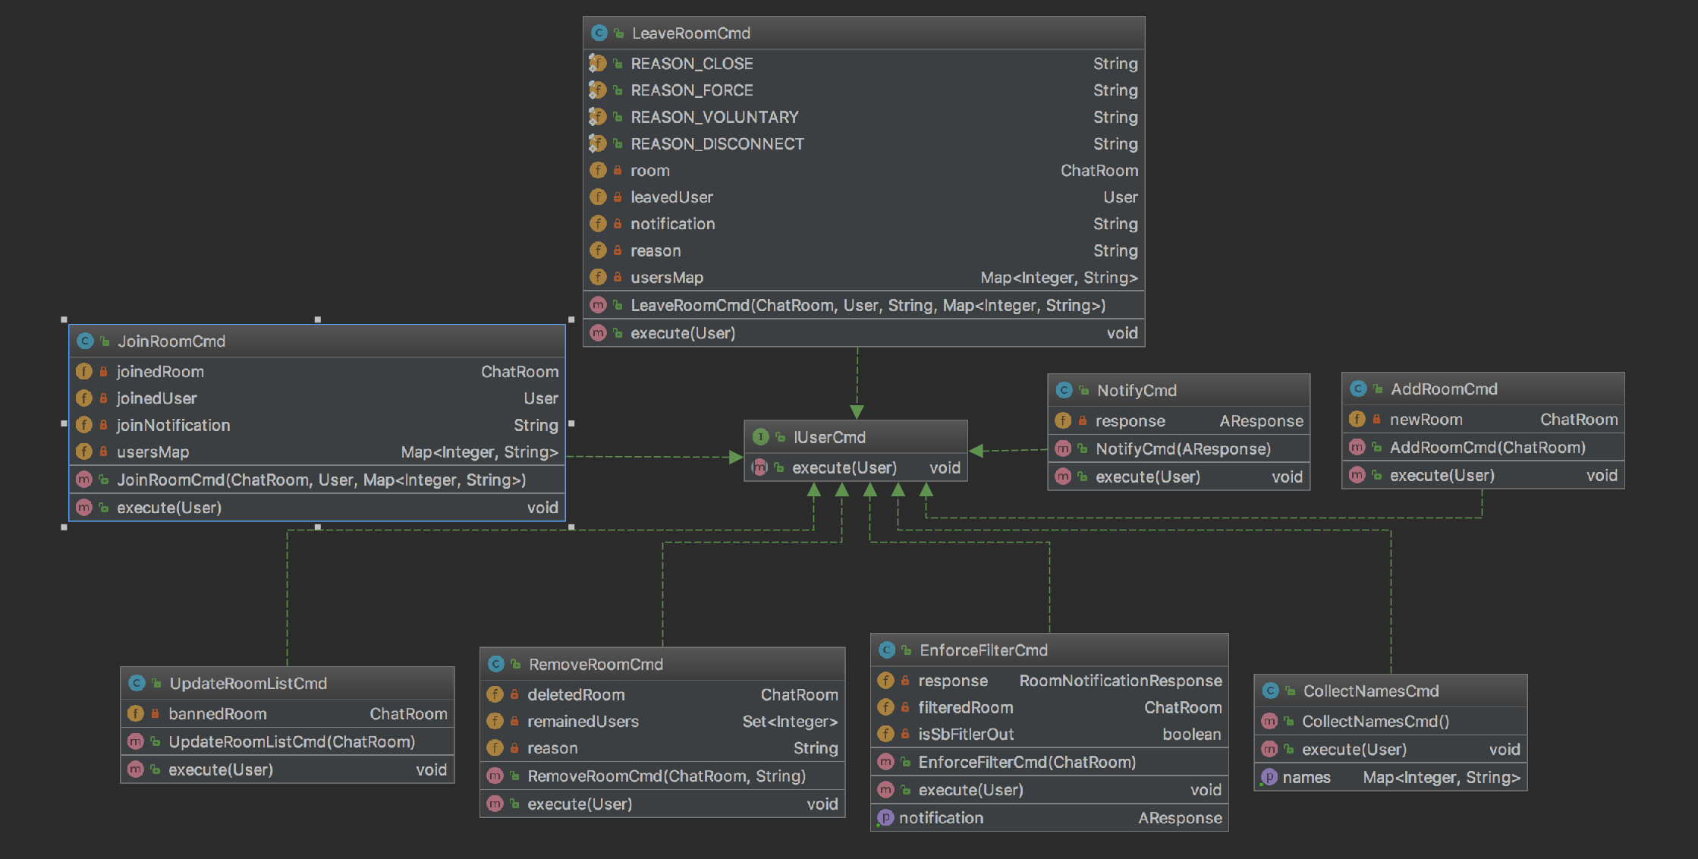
Package Cmd - UML

Slide 13
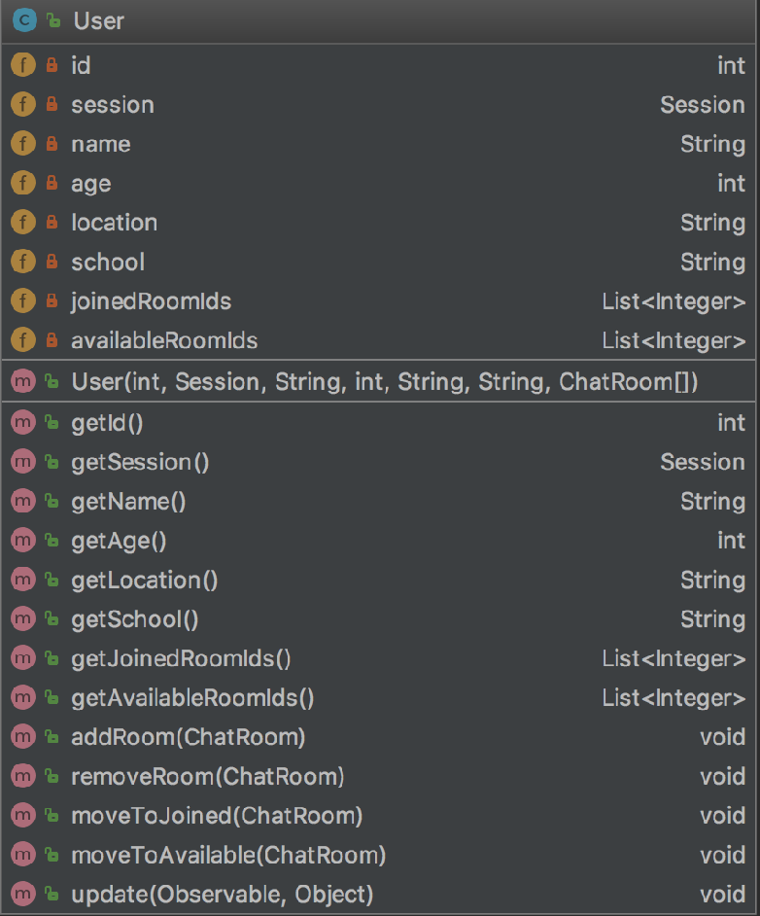
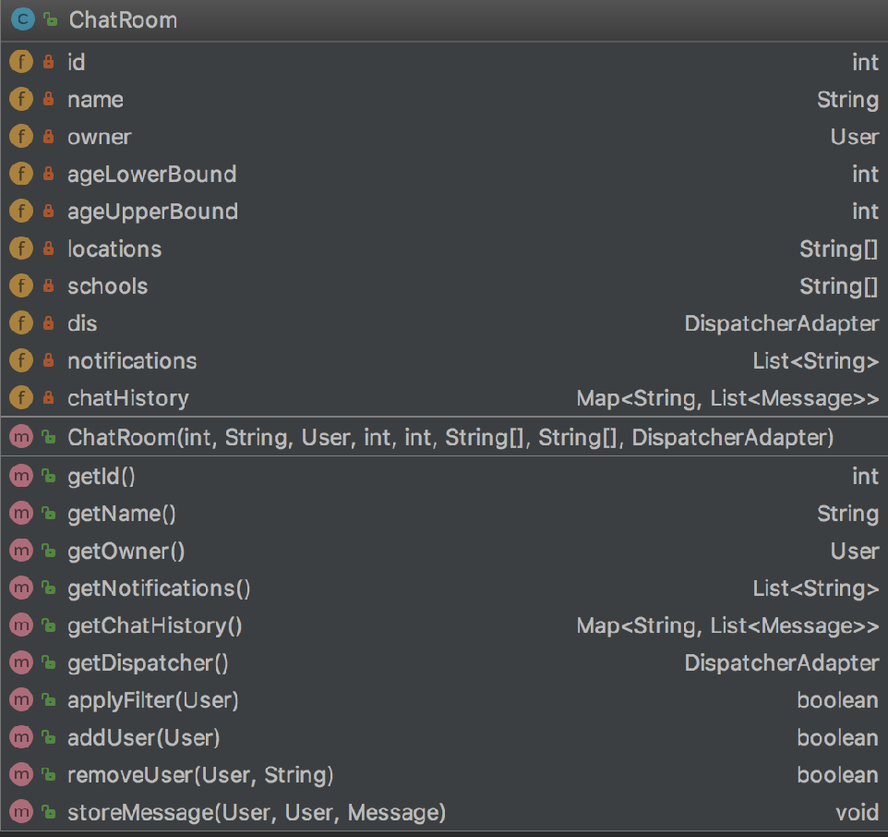
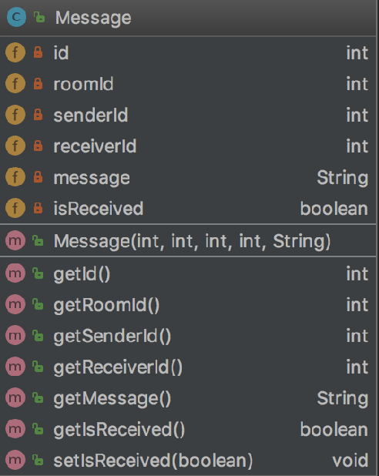
Package Obj - UML

Slide 14
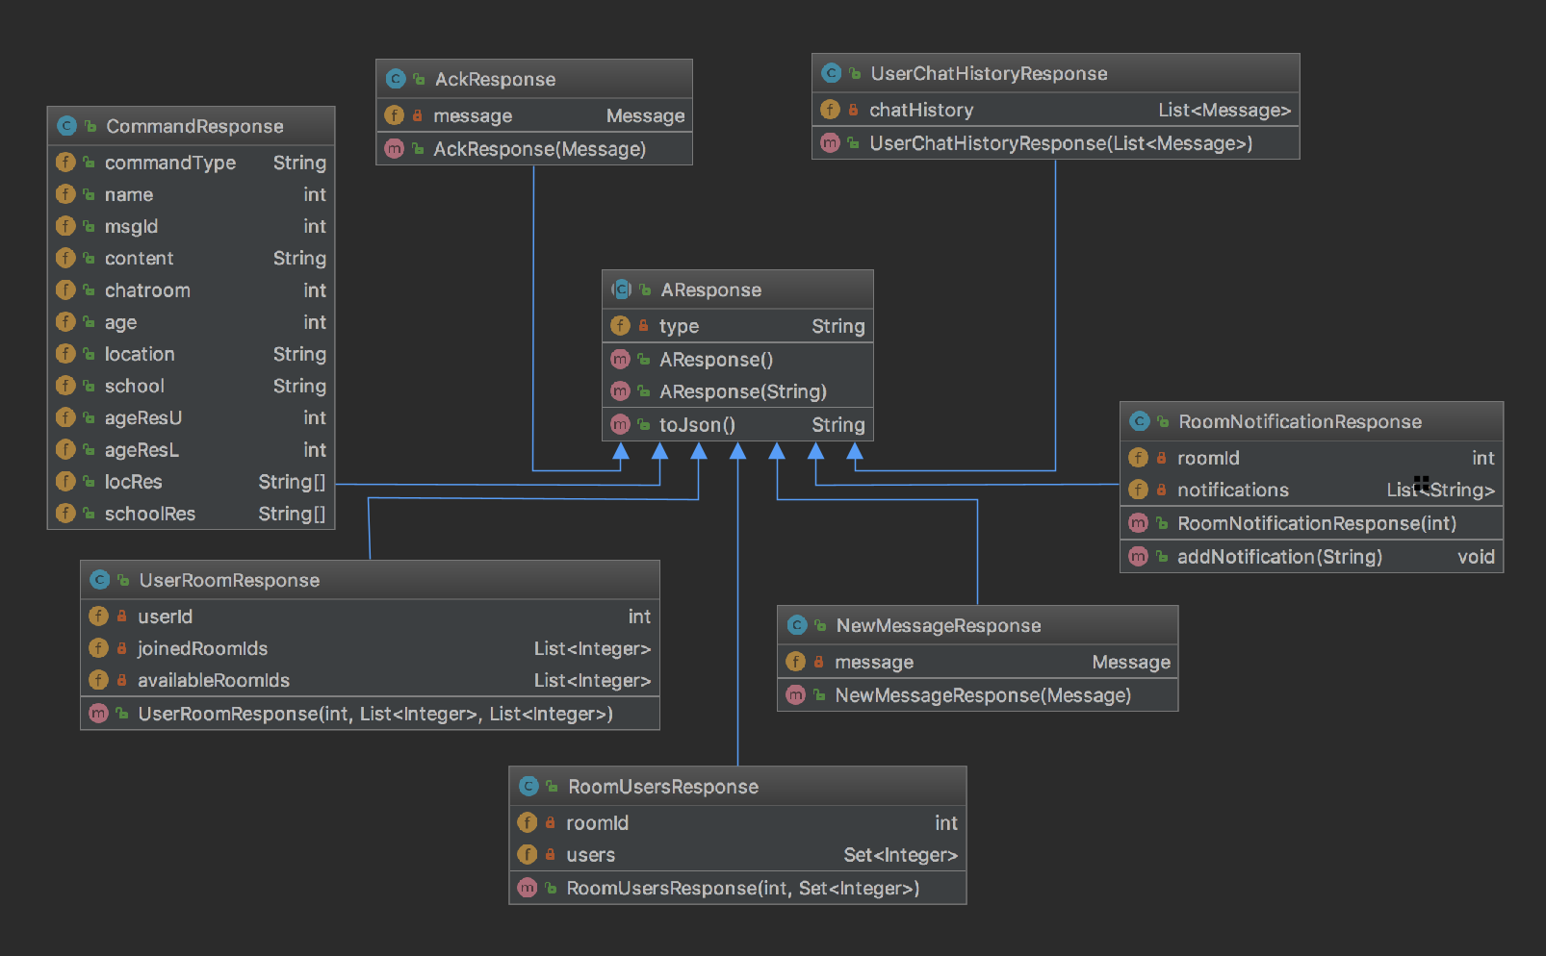
Package Res - UML

Slide 15

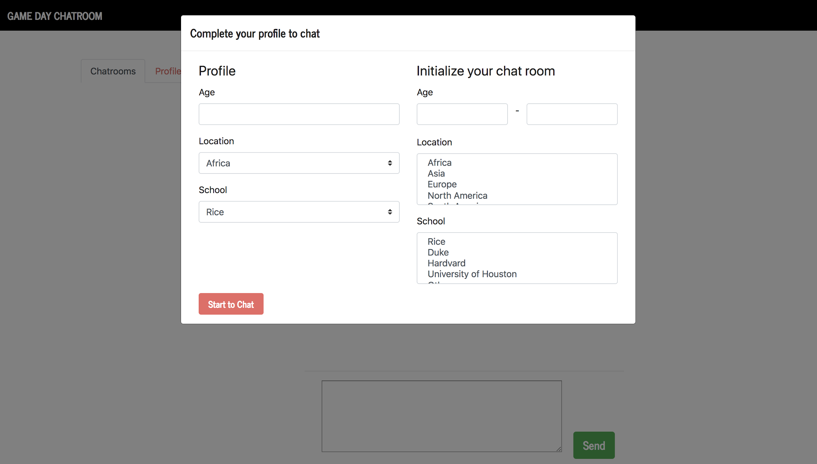
ChatApp -Demo

Slide 16
Q & A

